Slide 1


Muhammad Rayyan 12/16/2025

Slide 2







Executive Summary
Introduction
Methodology
Outline
Results
Conclusion
Appendix
2

Slide 3


Executive Summary
The project is about predicting if SpaceX’s Falcon 9 rockets will land successfully in the first stage. SpaceX’s provides it rockets at a much lower cost of 62 million dollars as compared to
other providers which is 165 million dollars, this is because SpaceX’s can reuse the first stage - IBM.
In this project I applied techniques such as API, web scraping for initial data collection, data wrangling for restructuring the data, EDA with visualization to get hidden insights, patterns and trends. Finally, I preprocessed the data using feature engineering before applying four different machine learning algorithms for predictive modeling to know whether the first stage of the Falcon 9 landing will be successful.
The results of the algorithms are almost all the same with an accuracy score of ~83.33%.
3

Slide 4
Introduction
I am a data scientist from SpaceY a rocket company founded by billionaire Allon Mask and my job is to use public information about competitor SpaceX to determine whether the first stage landing of their rockets will land successfully. Since SpaceX’s Falcon 9 is reusable. So that information from my research will be used by my company to bid against SpaceX’s.
I initially started my research by first collecting publicly available information from SpaceX’s API by making a request using the HTTP and BeautifoulSoup then flatten it into a pandas table for further analysis.
I later wrangle and restructured the data using pandas, the analysis was done with sqlite , matplotlib and seaborn for visual representations of my findings about the relationship between some of features which I used for prediction.
I then used Folium for visualizing the launch site and dash for interactive dashboard about the hidden relationship of whether the payload affect the successfully landing, or how the Orbit type and Flight Number affects success rate of landing.
The predictive modeling is mostly classification and binary using Logistic regression, Support vector machine, Decision tree and KNN with GridsearchCv for hyperparameter tuning. However, the dataset has a class ratio of 66.67%(class 1) success rate and how model can accurately predict 83.33% of it correctly.
4

Slide 5

5

Slide 6


Methodology
Executive Summary
Data collection methodology:
Perform
data wrangling
Perform exploratory data analysis (EDA) using visualization and SQL
Perform interactive visual analytics using Folium
and Plotly Dash
Perform predictive analysis using classification models
The data was collected using SpaceX API and Web scraping from wikipedia
Using pandas, I flatten the data into tabular structure, cleaned missing values.
Most of my work with models was were tune using GridsearchCv.
6

Slide 7

Data Collection
After a thorough research(reading) about SpaceX, I decided to use their publicly free API using HTTP python library to get the data in a json format. I then converted the json result into a data frame to extract all necessary information that will be useful
to my analysis. I filtered all “Falcon 1” data remaining with only “Falcon 9” which is
of most interest due to its successfully landing history over the past years.
I cleaned all missing values at this early stage leaving only LaunchingPad with nulls
indicating when no LauchPad was used during the launching process.
Here is a flow chart to show the process:
API request Data Frame Data Cleaning
Save/export cleaned data

Slide 8
Data Collection – SpaceX API
SpaceX URL , response,
Json,
Data Frame
Spacex_url
response
Response
content
Status
code
Json
Helper
function
DataFrame
GitHub SpaceX API calls notebook

Slide 9
Data Collection - Scraping
Static URL, Beautiful Soup, Data frame
GitHub URL web scraping notebook
Static URL
Request get
text
Beautiful
Soup
Tables
Column
names
Helper
function
DataFrame

Slide 10

Data Wrangling
The cleaned data was first imported, and I checked what percentage of missing values is in the LaunchingPad since it was the only column still containing missing value indicating when “no LaunchingPad” was used. I then checked the datatype of each column, there are 4 different datatypes(int64, object, float64 and bool). Further analysis like value count of LaunchSite was also examined for the various facilities Cape Canaveral Space Launch Complex 40 VAFB SLC 4E seem to have the highest count of 55.
I created a new feature called “class” from the outcome's column were all outcome containing the name “False” and “None” are regarded as bad, therefore a of zero(0) was assigned and one(1) for good outcome.
I also calculated the success rate of all the good outcome which make up 66.67% of the class
feature.
GitHub URL data wrangling related notebooks
Import
Columns value counts
Column Creation(Class)
Success Rate

Slide 11

EDA with Data Visualization
I extensive utilized seaborn and matplotlib for the visualization of static charts, plot type such as catplot for displaying the relationship between PayloadMass vs LaunchSite, barplot for orbit vs class and line plot to show the trend of average success rate of rocket launches over time(2010-2020).
GitHub URL EDA with data visualization notebook
11

Slide 12

EDA with SQL
Names of Unique launch sites in the space mission
Five records where launch sites begin with string ‘CCA’
Total payload mass by NASA (CRS)
Average payload mass carried by booster version F9 v1.1
First successful landing outcome in ground pad
Success in drone ship, payload mass >4000 but <6000
Total number of successful and failure mission outcomes
Booster_versions with maximum payload mass
Month names of failure landing outcomes in drone ship in year 2015
Landing outcome counts between "2010-06-04" and "2017-03-20“ in descending order
GitHub URL EDA with SQL notebook
12

Slide 13

Build an Interactive Map with Folium
In the interactive map with Folium, I added objects such as markers which is used to pin the location of the launches, examples is the NASA JSC space station launch site, circle to highlight the area with a text label on a specific coordinate and line for the proximity of the launchsites.
GitHub URL interactive map with Folium map

Slide 14

Build a Dashboard with Plotly Dash
In the Plotly Dash user application I have added a dropdown list and a range slider to allow a user to interact with a pie chart and the scatter point chart
GitHub URL Plotly Dash lab

Slide 15

Predictive Analysis (Classification)
The cleaned data was imported, and I assigned the features to a variable (X), and target to the variable(Y). The features were then scaled using sklearn’s the standard scaler() object, split with inbuilt “train_test_split” with a portion of 20% assigned to the testing.
The models were instantiated, hyperparameters assigned using “GridSearchCV” for optimal
best performing parameters.
Fitting was done on the training-set while the evaluation on the unseen test-set, the “DecisionTreeClassifier” models achieved the best results with an accuracy of 88.88% and F1-score of 88.21% using “GridSearchCV” for hyperparameter tuning.
Import data
Assign (features and Target)
Feature engineered
Split (train-test)
Model
Evaluate
GitHub URL predictive analysis lab

Slide 16

Results
The finding of the exploratory stage were quite interesting with NASA (CRS) having a total “payload mass” of 45,596, average payload_mass of “booster version F9 v1.1” is 2928.4, first successful landing outcome ground pad was achieved in “2015-12-22”,
and up to 5 Booster_version having a successful landing_outcome on “drone_ship” with payload_mass between (4000,6000). A total of 99 success mission_outcome was also achieved by SpaceX’s Falcon 9.
The visualization also depict some interesting findings, with higher success rate for CCAFS SLC 40 as the filight number increases, and higher success rate(100%) of Falcon 9 landing for Obit type “ ES-L1, SSO, HEO and GEO). Also there has been tremendous
success in Falcon 9’s first stage landing over time since 2010 to 2020.

Slide 17
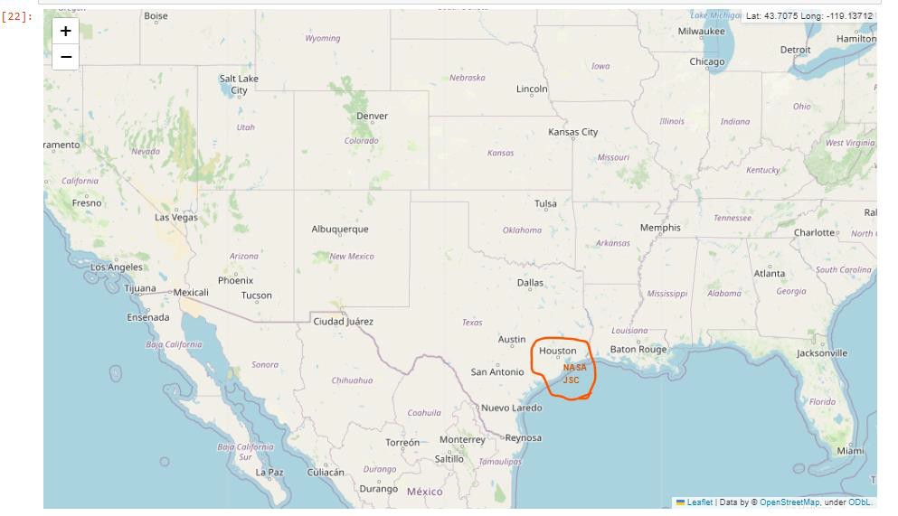
Results
Nasa Johnson Space Station (NASA JSC)
Source: Folium Github notebook

Slide 18
Results
I used four(4) different machine learning algorithms the baseline Logistic Regression, Support Vector Machine, Decision Tree classifier and KNN. All the models yield a better performance with and accuracy above 83%, while Decision Tree with GridSearchCV achieved the highest accuracy of 88.89% and F1-score of 88.21%. Meaning we are confident enough that 88.89% of the time our model will be able to predict whether Falcon 9 first stage landing will be successful.

Slide 19

Section 2

Slide 20
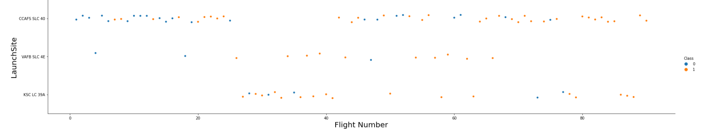
Flight Number vs. Launch Site
As show above the relationship between Flight Number and LaunchSite, we can see that with
lower flight number (20) there’s no failure or success metric for “KSC LC 39A”, but two
failures for the “VAFB SLC 4E”. But as the flight number increases past 80, there are more success “CCAFS SLC 40” and none for “VAFB SLC 4E”.
Source: GitHub
20

Slide 21
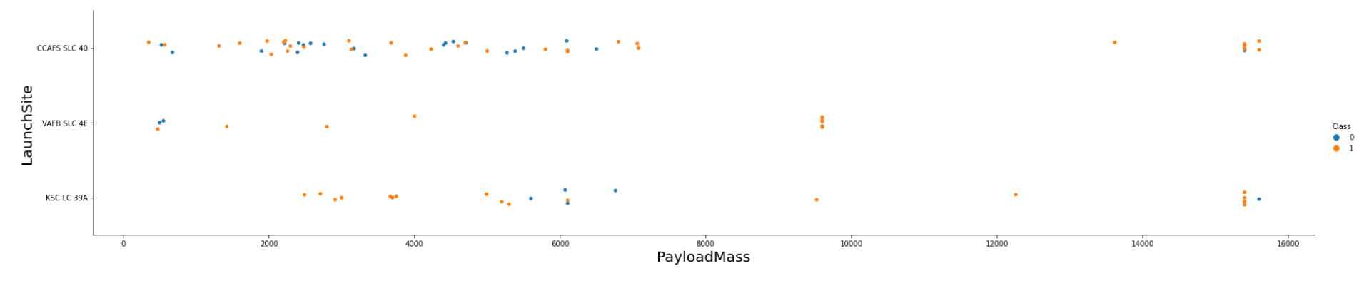
Payload vs. Launch Site
As show above the relationship between Flight Number and LaunchSite, we can see that with lower flight number (20) there’s no failure or success metric for “KSC LC 39A”, but two failures for the “VAFB SLC 4E” and more failures than success for “CCAFS SLC 40”. But as the flight number increases past 80, there are more success “CCAFS SLC 40” and none for “VAFB SLC 4E”.
Source: GitHub

Slide 22
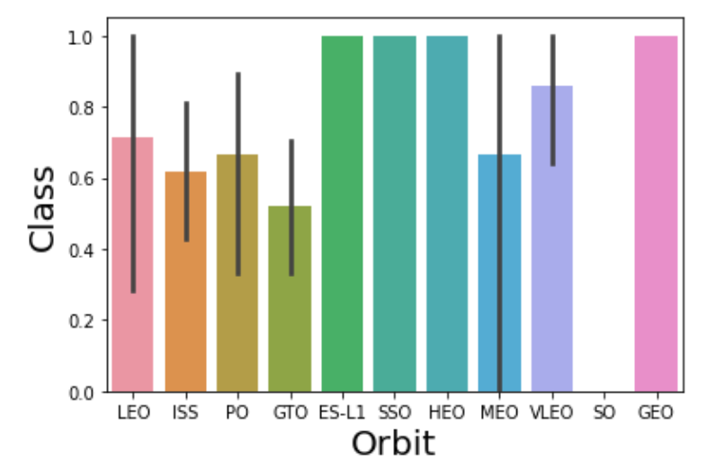
Success Rate vs. Orbit Type
Four(4) Orbit type have the highest success rate of 100% ES-L1, SSO, HEO, and GEO.
Source: GitHub

Slide 23
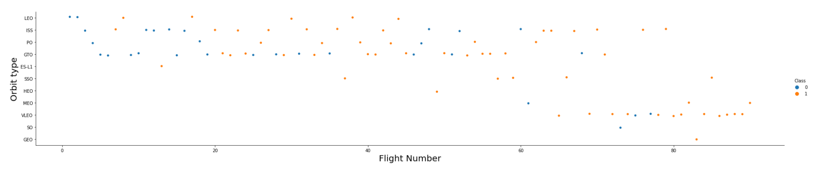
Flight Number vs. Orbit Type
You can see that in the VLEO orbit there seem to be success rate only when the flight number is greater than 60. While there seem to be no relationship in the GTO.
Source: GitHub
23

Slide 24
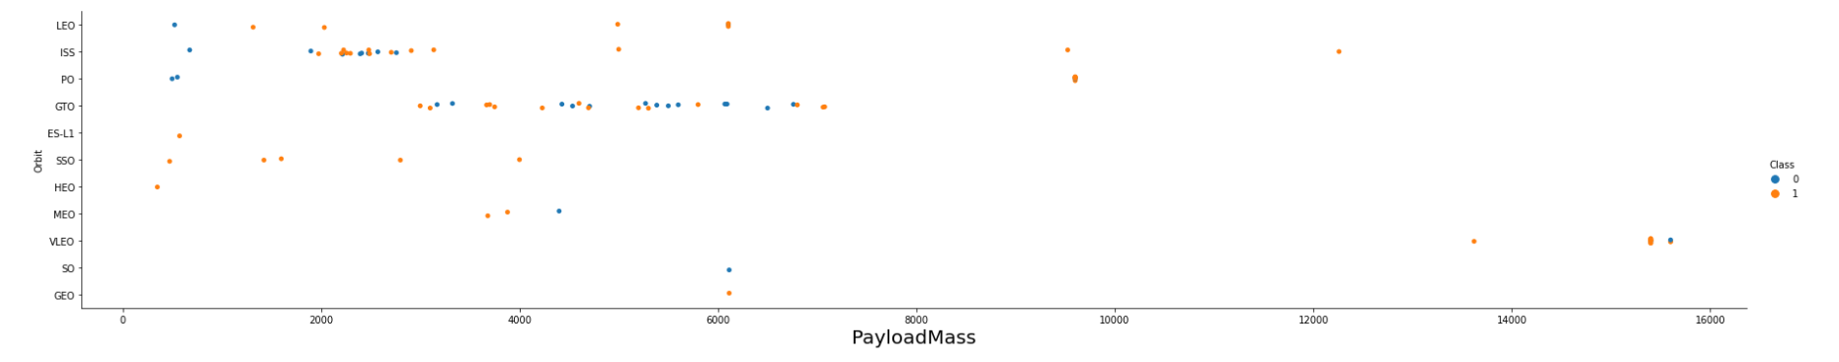
Payload vs. Orbit Type
There is more positive landing rate with heavy payloads for Polar, LEO and ISS, however for
GTO there’s the presence of both positive and negative landing.
Source: GitHub
24

Slide 25
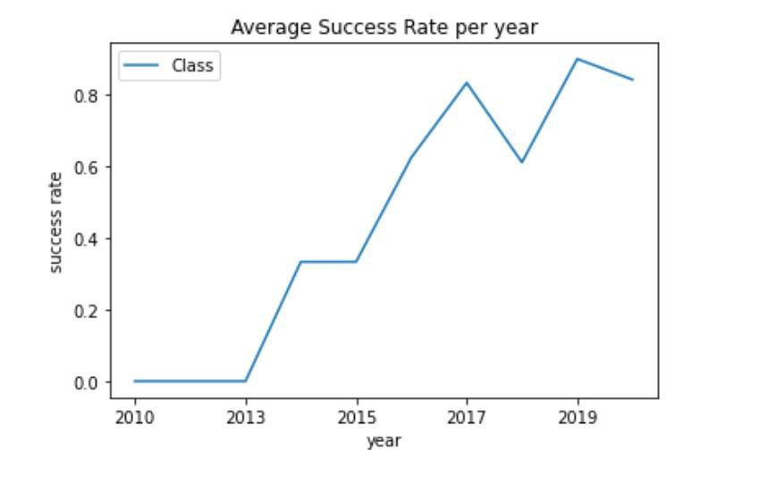
Launch Success Yearly Trend
The yearly success rate of Falcon 9 landing kept increasing since 2013
till 2020.
Source: GitHub
25

Slide 26
All Launch Site Names
The name of unique launch sites are:
CCAFS LC-40: Space Launch Complex 40 formerly Launch Complex 40 ( LC-40 ) is an orbital launch pad located in northern Cape Canaveral , Florida (Wikipedia).
VAFB SLC-4E: Vandenberg AFB Space Launch Complex 4 is a launch and landing site at Vandenberg Space Force Base, California, U.S. It has two pads, both of which are used by SpaceX for Falcon 9, one for launch operations, and other as Landing Zone 4 for SpaceX landings(Wikipedia).
KSC LC-39A: Kennedy Space Center Launch Complex 39A Launch Complex 39A is the first of Launch Complex 39's three launch pads, located at NASA's Kennedy Space Center in Merritt Island, Florida(Wikipedia).
S
ource: GitHub

Slide 27
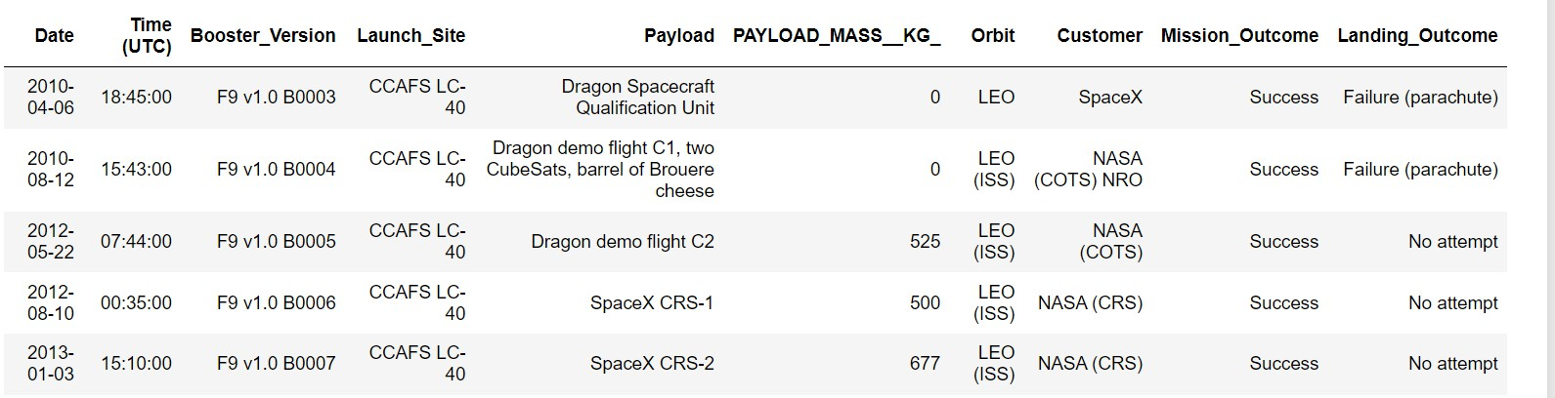
Launch Site Names Begin with 'CCA'
Attached below is a list of the first five Launch Site whose names begin with “CCA”
Source: GitHub

Slide 28
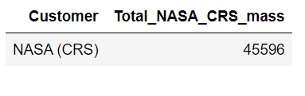
Total Payload Mass
The total payload mass of boosters from NASA is 45596.
Source: GitHub

Slide 29
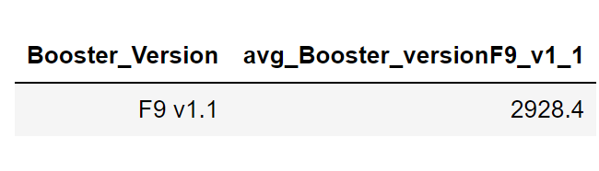
Average Payload Mass by F9 v1.1
The average payload mass carried by booster version F9 v1.1 is 2928.4
Source: GitHub

Slide 30
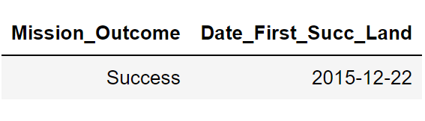
First Successful Ground Landing Date
The dates of the first successful landing outcome on ground pad is:
Source: GitHub

Slide 31
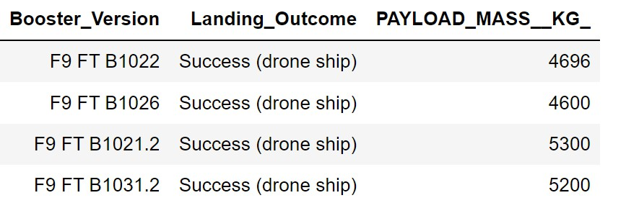
Successful Drone Ship Landing with Payload between 4000 and 6000
The names of boosters which have successfully landed on drone ship and had payload
mass greater than 4000 but less than 6000 are as follows:
Source: GitHub
31

Slide 32
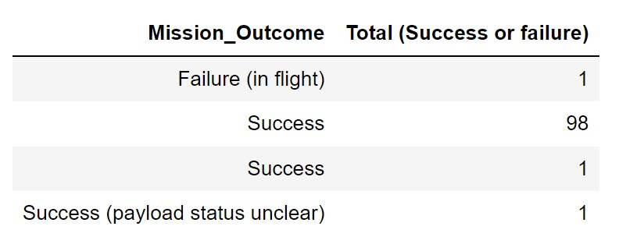
Total Number of Successful and Failure Mission Outcomes
The total number of successful and failure mission outcomes are 99 for success
one for Failure (in flight) and 1 for success (payload status unclear).
Source: GitHub

Slide 33
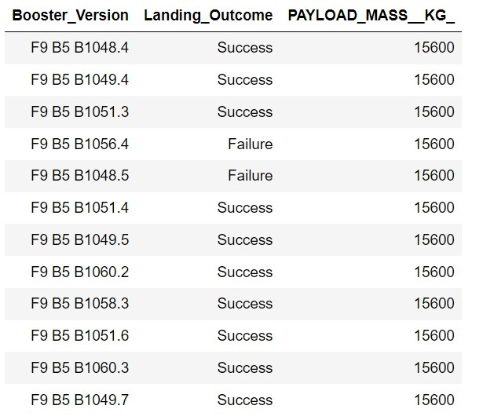
Boosters Carried Maximum Payload
List of the booster which have carried the maximum payload mass
Source: GitHub

Slide 34
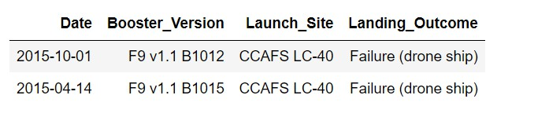
2015 Launch Records
List the failed landing_outcomes in drone ship, their booster versions,
and launch site names for in year 2015
Source: GitHub

Slide 35
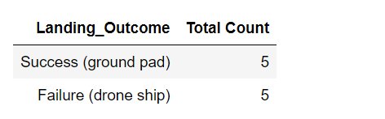
Rank Landing Outcomes Between 2010-06-04 and 2017-03-20
Rank of landing outcomes (such as Failure (drone ship) or Success (ground pad)) count between the date 2010-06-04 and 2017-03-20, in descending order.
Source: GitHub

Slide 36

Section 3

Slide 37
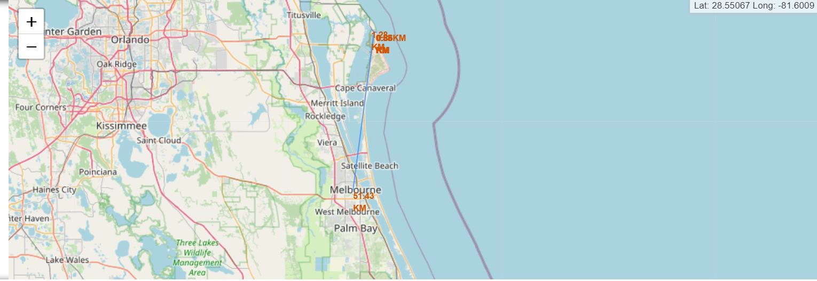
Proximities
proximities such as railway, highway, coastline, with distance calculated and displayed.
37

Slide 38

Section 4

Slide 39
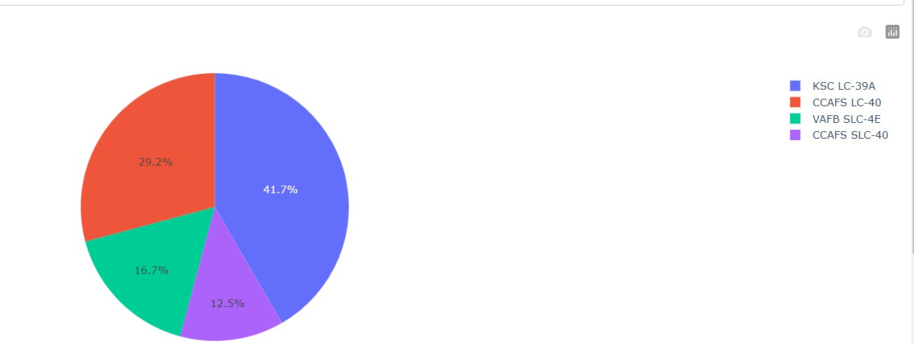
Pie chart of all the launch sites
KSC LC-39A makes up 41.7% of the piechart showing it has more launches than the other sites, followed by CCAFS LC-40 with 29.2%.

Slide 40
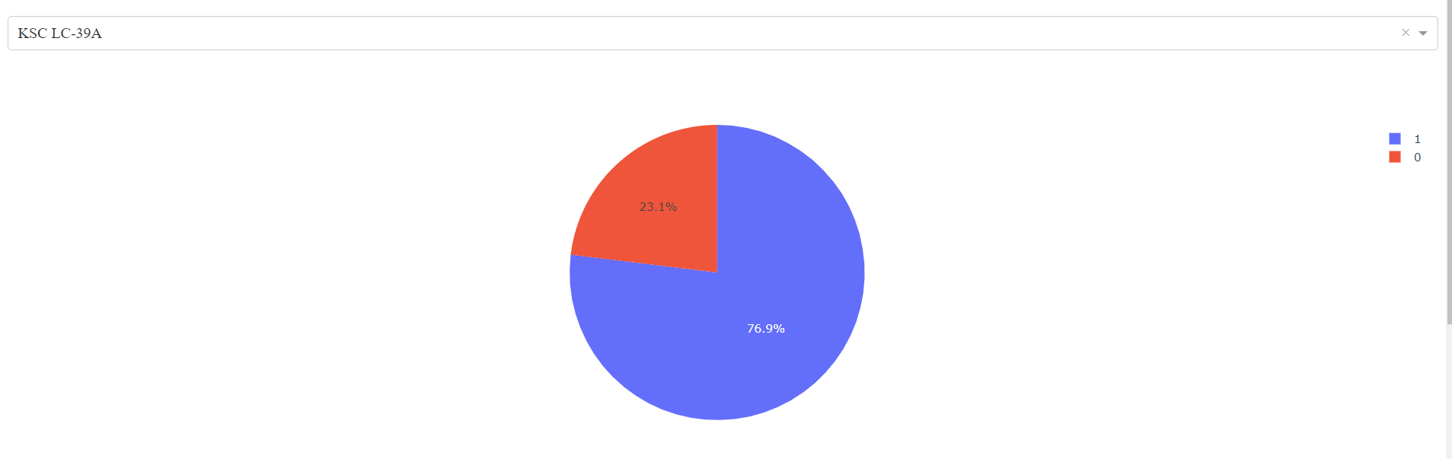
Pie chart of KSC LC 39A
Site KSC LC 39A has a higher count with a 76.9% success rate of Falcon 9 landing.

Slide 41
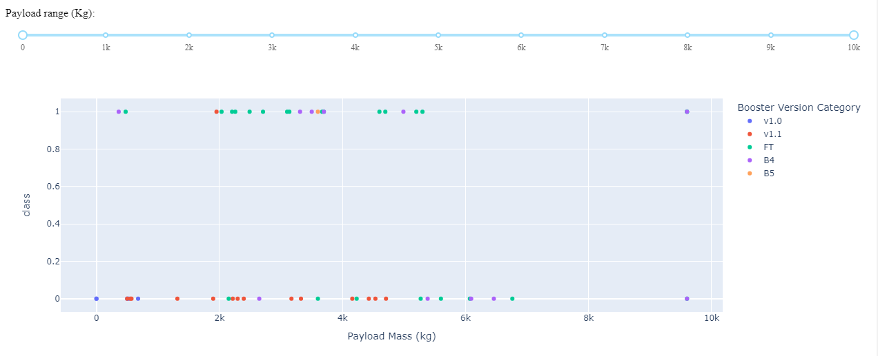
Payload vs. Launch Outcome scatter
We can see in the scatter plot that as payload mass grow so does the success rate for the booster version FT, while the opposite for booster version v1.1 which has more failures.

Slide 42

Section 5

Slide 43
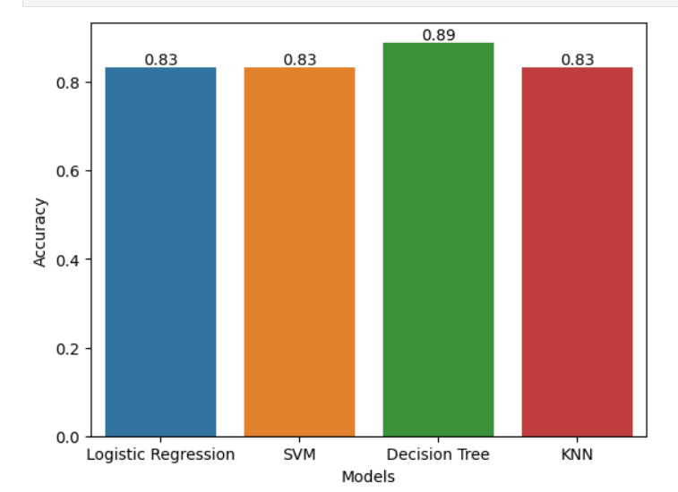
Classification Accuracy
Decision Tree was the best classifier with and accuracy of 88.88%

Slide 44
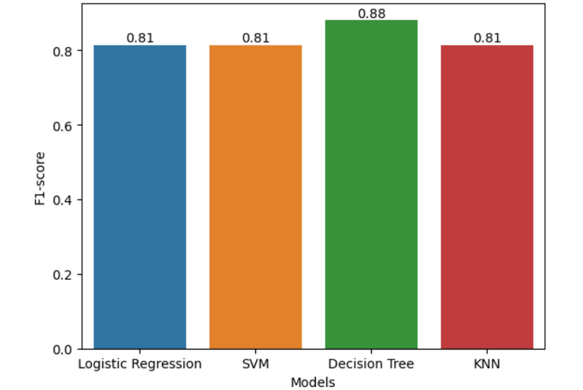
Classification F1-score
Decision Tree also achieved
an F1-score of 88.88%.

Slide 45
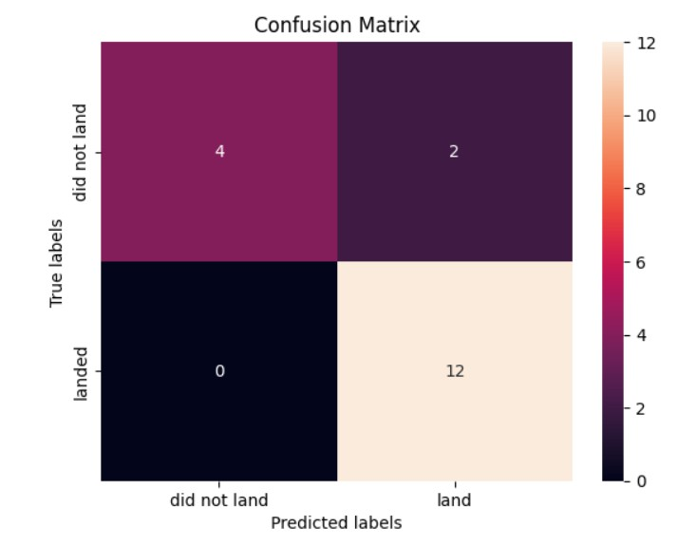
Confusion Matrix
The Decision tree model has 2 false-positive and no false negative and achieved a precision accuracy of 85.71% while recall is 100%.

Slide 46
Conclusions
As the flight number increases there’s more success rate for Launch Site CCAFS SLC 40,
the same relationship was observed for payload mass.
There’s 100% success rate of landing for Orbit type ES-L1, SSO, HEO, and GEO
There’s been stead increase in the success rate of Falcon 9 landing since 2010-2020
With a very high accuracy of 88.89%, we know that our model can predict the outcome of the landing.

Slide 47
Appendix
All relevant assets like Python code snippets, SQL queries, charts, Notebook outputs, and data sets included in this presentation can be found on my GitHub.

Slide 48


